Slide 1
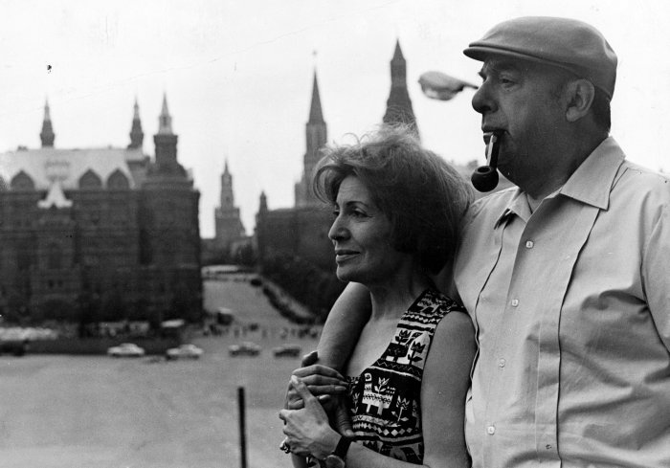
Pablo Neruda & Love
By Taylor Sadhi & Kerbyn Gauthier

Slide 2
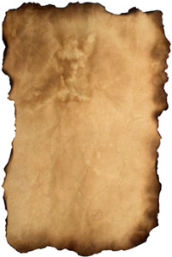
Love
Pablo Neruda wrote in a variety of styles, including and erotically charged love poems such as the ones in his collection Twenty Love Poems and a Song of Despair (1924).
He often wrote in green ink, which was his personal symbol for desire and hope

Slide 3
Start of his Love Life
In Java he married his first wife, a Dutch bank employee named Maryka Antonieta Hagenaar Vogelzang.
While their daughter was sick, Neruda slowly became separated from his wife and began a relationship with Delia del Carril, an Argentine women.
His first marriage broke down and the couple divorced in 1936. His ex-wife moved to Monte Carlo and then to the Netherlands with their only child, and he never saw either of them again. After leaving his wife, Neruda lived with Delia del Carril in France.

Slide 4
Love Life
When he was in Mexico City,, he married del Carril, and learned that his daughter Malva had died, aged eight, in the Nazi-occupied Netherlands.
This was a Bonnie & Clyde relationship, while she didn’t commit any crime he was exiled, they always found themselves hiding from the feds smuggling from house to house in their hometown of Chile. They later split pathways.
When he was visiting other countries, he became sick and met Chilean singer named Matilde Urrutia who was hired to care for him and they began an affair that would, years later, culminate in marriage.

Slide 5
Love Life
During his exile, Urrutia would travel from country to country shadowing him and they would arrange meetings whenever they could.
He returned to Chile and was reunited with his second wife, however their marriage was crumbling, she then realized of the affair with Urrutia.

Slide 6
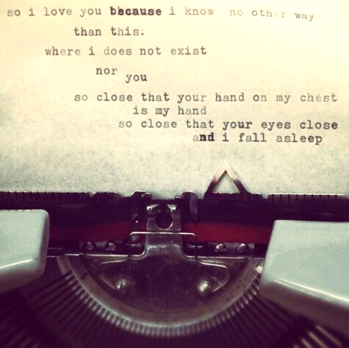
His Most Influential Love Affair
Matilde Urrutia was poet Pablo Neruda's lover, muse, wife, and widow. The Nobel-laureate Chilean wrote The Captain's Verses and One Hundred Love Sonnets—two of the most celebrated volumes of love lyrics in modern Spanish letters—for her.

Slide 7
Some Of His Love Quotes
“I love you without knowing how, or when, or from where. I love you simply, without problems or pride: I love you in this way because I do not know any other way of loving but this, in which there is no I or you, so intimate that your hand upon my chest is my hand, so intimate that when I fall asleep your eyes close.”
“I love you as certain dark things are to be loved, in secret, between the shadow and the soul.”
“Love is so short, forgetting is so long.”

Slide 8
20 Love poems & a Song of Despair
https://www.youtube.com/watch?v=yN3v3WoaR_Y
Tonight I can write the saddest lines.
Write, for example,'The night is shattered
and the blue stars shiver in the distance.'
The night wind revolves in the sky and sings.
Tonight I can write the saddest lines.
I loved her, and sometimes she loved me too.
Through nights like this one I held her in my arms
I kissed her again and again under the endless sky.
.

Slide 9
100 Love Sonnets
Sonnet LXII (from “Evening” in 100 Love Sonnets)
Woe is me, woe is us, my dearest:
we wanted only love, to love one another,
but among so many griefs it was fated
that only we two would be so hurt.
We wanted the you and the me for ourselves,
the you of a kiss, the me of a secret bread:
and that’s how it was, infinitely simple,
till hatred came in through the window.
They hate, those who did not love our love,
nor any other love: those people,
wretched as chairs in an empty room–
till they were tangled in ashes,
till their ominous faces
faded in the fading twilight.

Slide 10
Discussion Questions
With your understanding new understanding of Pablo Neruda’s love life do you believe that it greatly influenced his works?
Do you think Pablo Neruda’s works would be completely centered by his love life or is it influenced by other things?

